Slide 1

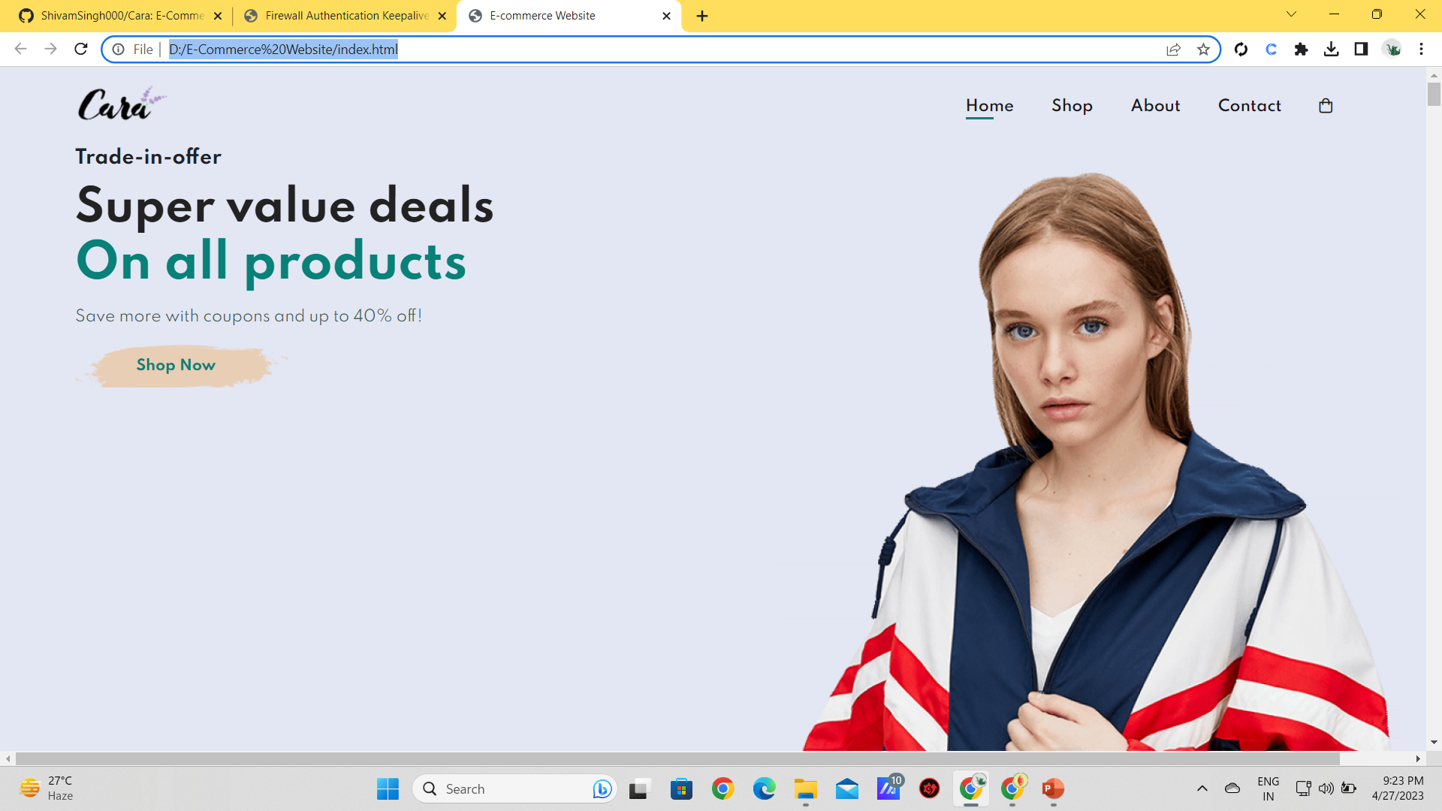
MINI PROJECT - II
https://github.com/ShivamSingh000/Cara

Slide 2
LANGUAGES USED
HTML – HTML stands for Hypertext Markup Language. It is used for creating web pages and web applications.
CSS - CSS stands for Cascading Style Sheets. It is a style sheet language which is used to describe the look and formatting of a document written in markup language.
JavaScript - It is a scripting language used to create and control dynamic website content, i.e. anything that moves, refreshes, etc.

Slide 3
LANGUAGES USED
Bootstrap – It is a collection of HTML, CSS and JavaScript tools used for creating and building web pages and web applications.
Google Firebase - Firebase is an app development platform that helps you build and grow apps and games users love. Backed by Google and trusted by millions of businesses around the world.
PHP - PHP(short for Hypertext PreProcessor) is the most widely used open source and general purpose server-side scripting language used mainly in web development to create dynamic websites and applications.

Slide 4
TEAM MEMBERS
Shivam Prakash Singh 201500653
Ansh Malhotra 201500109
Sushant Kumar Singh 201500727
Apurva Vashistha 201500138

Slide 5
HOME PAGE
Have A Look At Our Home Page Which Definitely Gives You an Overview of Website features

Slide 6
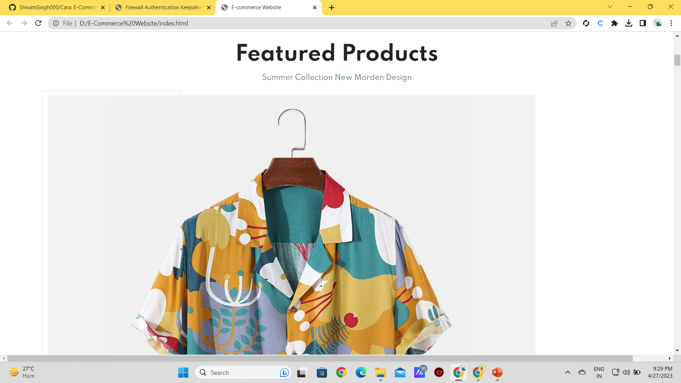
Featured Products PAGE
Here is our Featured Production Section

Slide 7
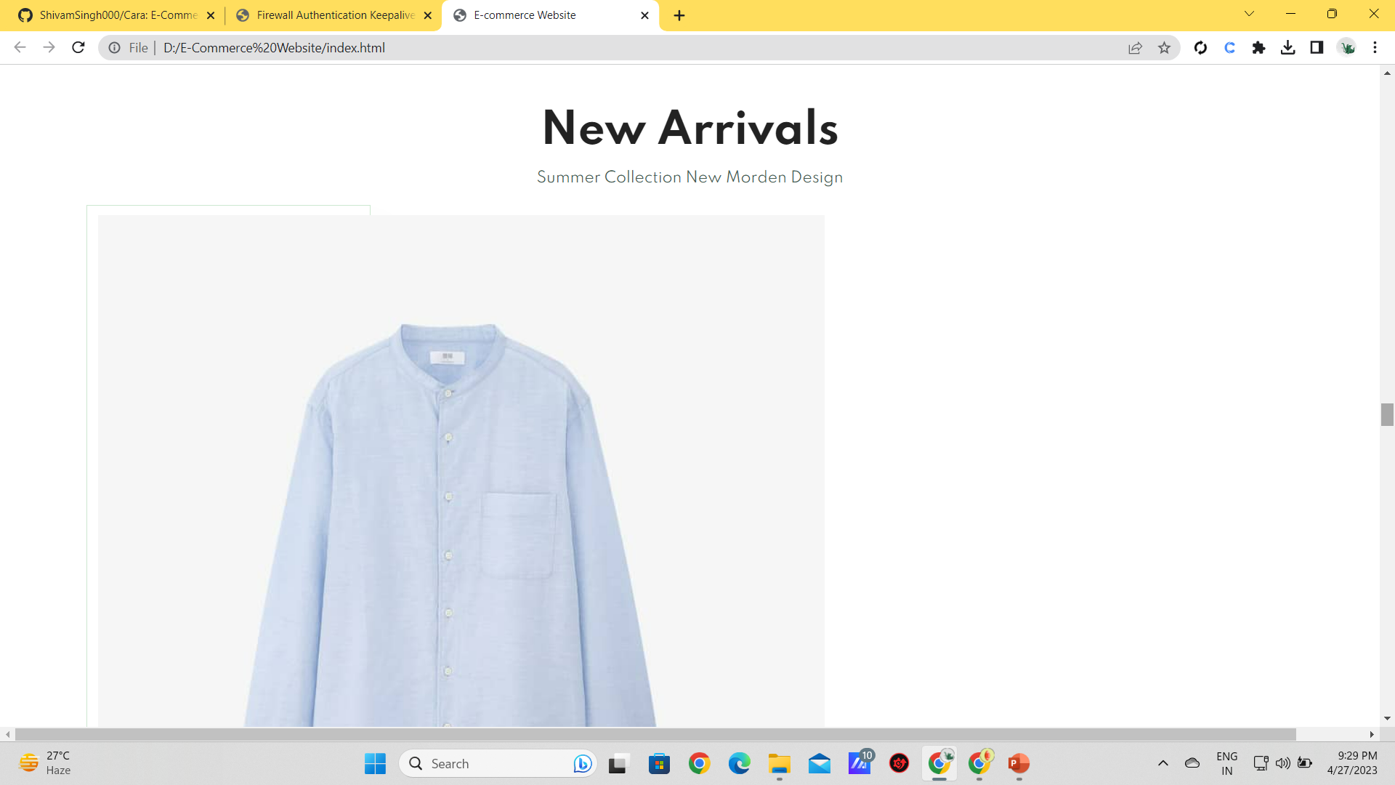
New Arrival Page
Here is our New Arrival Page

Slide 8
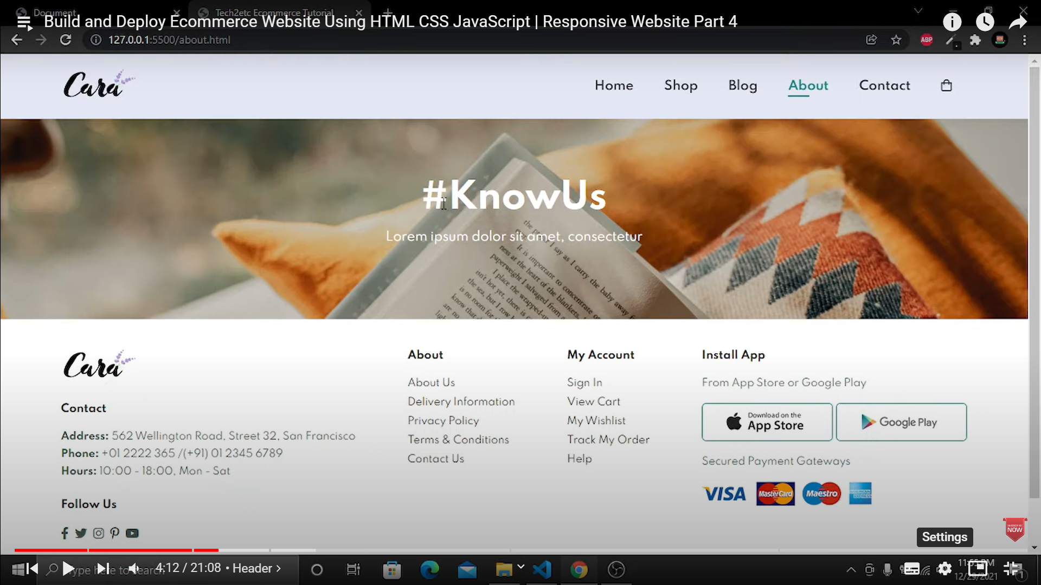
ABOUT US PAGE
Gives you a glimpse of the insight features of our website

Slide 9
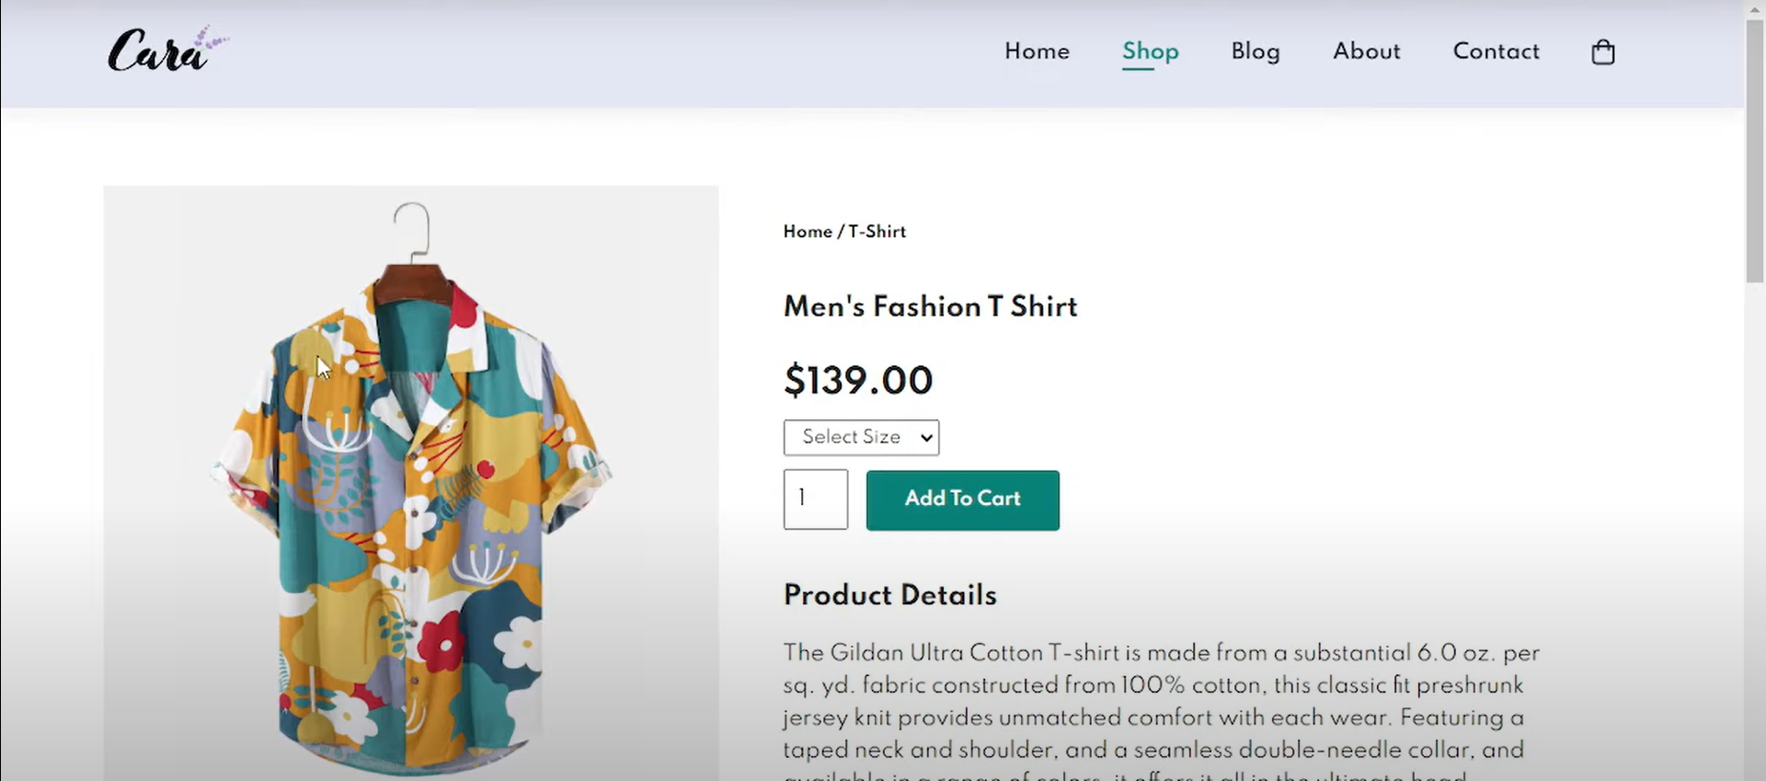
Shopping Page
Here You Can Shop The Products

Slide 10
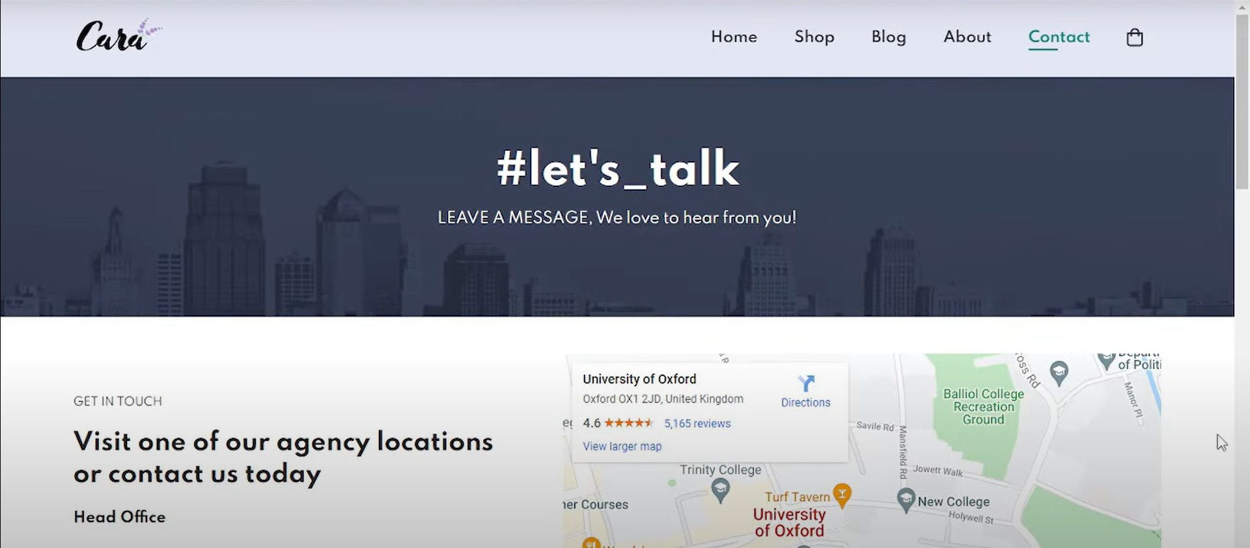
Contact Us Page
Here Customer Can Contact Us For Any Assistant

Slide 11
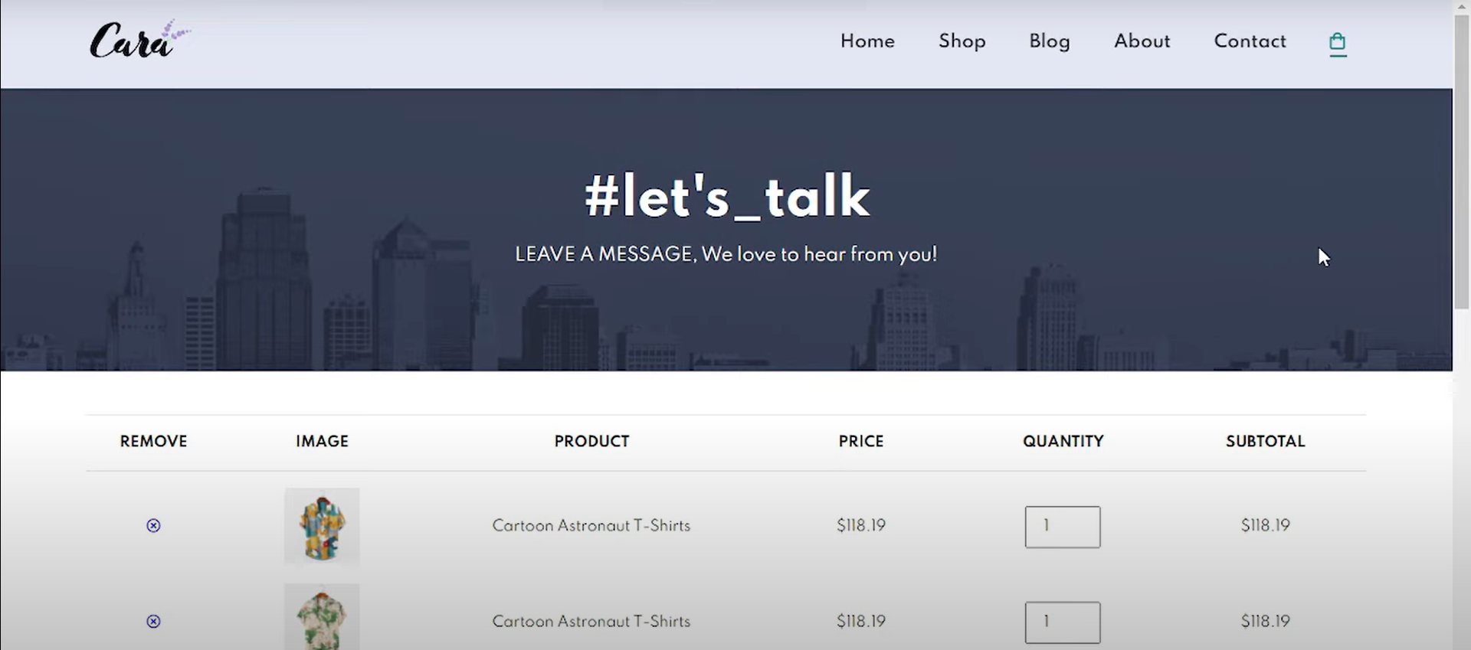
Add Items(Cart) Page
On this Page Customers Can Add, Delete Or Edit Items In Their Cart

Slide 12
THANK YOU
We are waiting to receive your valuable feedback

